Slide 1
PHP Essential Training
From Lynda & W3Schools

Slide 2
What is PHP?
Server-side scripting language
PHP is a widely-used, free, and efficient alternative to competitors such as Microsoft's ASP.
PHP 7 is the latest stable release.

Slide 3
Script
Runs in response to an event
Performs instruction from top to bottom
Little or no user interaction
Program
Runs even when not responding to events
Jumps around instructions
Lots of user interaction

Slide 4
What PHP can do?
PHP can generate dynamic page content
PHP can create, open, read, write, delete, and close files on the server
PHP can collect form data
PHP can send and receive cookies
PHP can add, delete, modify data in your database
PHP can be used to control user-access
PHP can encrypt data

Slide 5
What do you need?
PHP Web Server (XAMPP)
With MySQL Server (XAMPP)
XAMPP – It includes Apache web server with PHP support built in.
XAMPP stands for cross platform support for Apache, MariaDB (MySQL), PHP and Perl.
Always start Apache and MySQL

Slide 6
XAMPP folder structure
Commonly found in \user\xampp or in windows C:\xampp
htdocs folder – Where Apache web server will expose to the web

Slide 7
Basic syntax
<?php phpinfo(); ?>

Slide 8
Basic output
<?php
echo “hello world”;
?>

Slide 9
PHP Comments
// This is a line comment
# This is another line comment
/*
* This is a block comment
*/

Slide 10
Variables
$username
$user_access
$accessControl
$SERVER_NAME

Slide 11
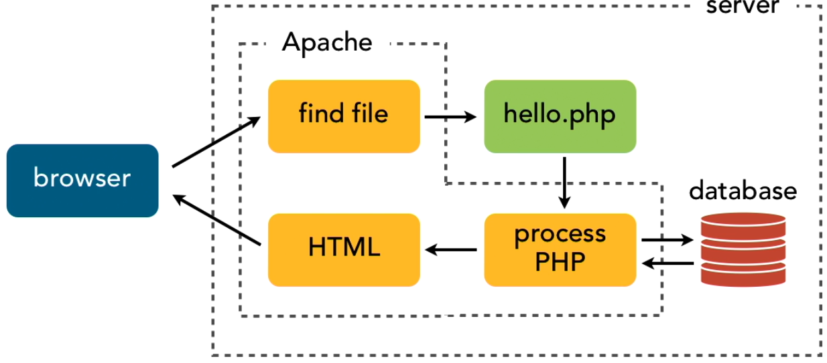
How PHP works?

Slide 12
PHP is a loosely typed language
It means PHP automatically associates a corresponding data type to a variable depending on its value.
BUT in PHP 7 we can specify what data type is to a given variable by enabling the “strict” requirement.

Slide 13
PHP supported data types
String
Integer
Float (floating point numbers - also called double)
Boolean
Array
Object
NULL
Resource

Slide 14
PHP constants
<?php
define(“GREET”,”Hello”);
echo GREET;
?>

Slide 15
PHP arrays
Array is a special variable that can hold many values at once.
Indexed array
Associative array
Multidimensional array
Sorting array

Slide 16
Indexed array
<?php
$cars = array("Honda", "Ford", "Toyota");
echo "I like " . $cars[0] . ", " . $cars[1] . " and " . $cars[2] . ".";
?>

Slide 17
Associative array
<?php
$players[“yhanskie”] = 60;
$players[“dwaRfed34”] = 25;
$players[“jun_jun29”] = 94;
?>

Slide 18
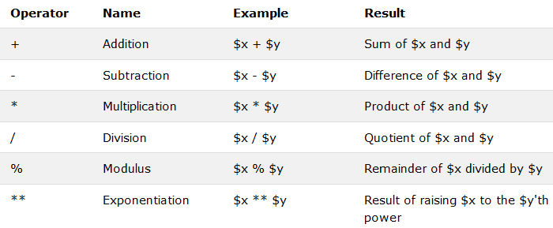
PHP arithmetic operators

Slide 19
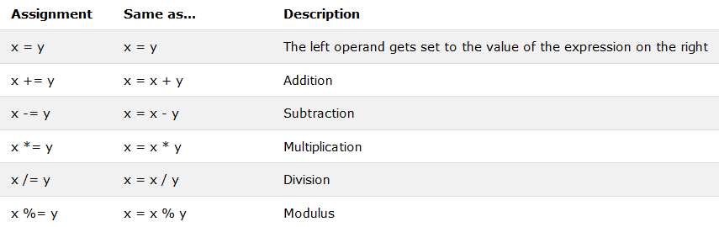
PHP assignment operators

Slide 20
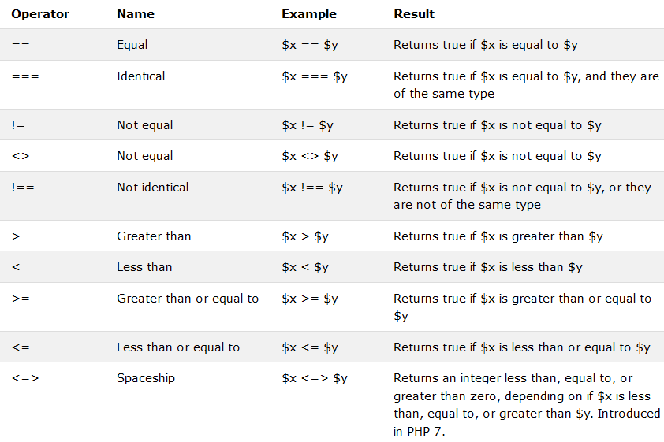
PHP comparison operators

Slide 21
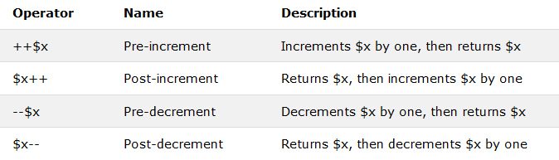
PHP increment and decrement operators

Slide 22
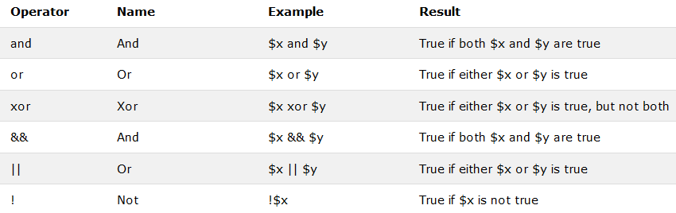
PHP logical operators

Slide 23
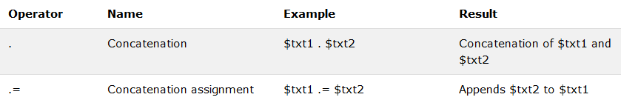
PHP string operators

Slide 24
PHP conditional statements
if statement - executes some code if one condition is true
if...else statement - executes some code if a condition is true and another code if that condition is false
if...elseif...else statement - executes different codes for more than two conditions
switch statement - selects one of many blocks of code to be executed

Slide 25
if (condition) {
code to be executed if condition is true;
}

Slide 26
Switch statement
switch (n) {
case label1:
code to be executed if n=label1;
break;
case label2:
code to be executed if n=label2;
break;
case label3:
code to be executed if n=label3;
break;
...
default:
code to be executed if n is different from all labels;
}

Slide 27
Loops
while - loops through a block of code as long as the specified condition is true
do...while - loops through a block of code once, and then repeats the loop as long as the specified condition is true
for - loops through a block of code a specified number of times
foreach - loops through a block of code for each element in an array

Slide 28
Do while and While loop
while (condition is true) {
code to be executed;
}
do {
code to be executed;
} while (condition is true);

Slide 29
For loop
for (init counter; test counter; increment counter) {
code to be executed for each iteration;
}

Slide 30
Foreach loop
foreach ($array as $value) {
code to be executed;
}

Slide 31
PHP functions
A function is a block of statements that can be used repeatedly in a program.
A function will not execute automatically when a page loads.
A function will be executed by a call to the function.

Slide 32
PHP functions
function functionName() {
code to be executed;
}

Slide 33
Form handling
$_GET and $_POST are SUPER GLOBALS that collects user data.

